Slide 1
The Supply Chain Process: From Manufacture to End User
Understanding the Journey of a Product

Slide 2
Introduction
What is a Supply Chain?
A system of organizations, people, activities, information, and resources involved in moving a product from supplier to customer.
Importance of Supply Chain Management:
Ensures product availability
Minimizes costs
Enhances customer satisfaction

Slide 3
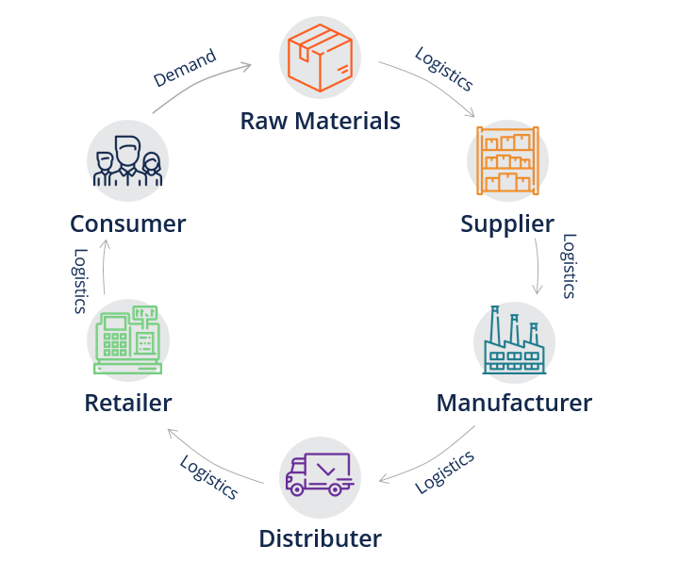
Key Components of the Supply Chain
Suppliers
Manufacturers
Distributors
Retailers
End Users

Slide 4
Suppliers
Role of Suppliers:
Provide raw materials and components
Quality Assurance
Cost Management
Example:
Supplier of raw materials for electronics (metals, plastics, etc.)

Slide 5
Manufacturers
Role of Manufacturers:
Convert raw materials into finished products
Process:
Production planning
Manufacturing operations
Quality control
Example:
Factory assembling smartphones

Slide 6
Distributors
Role of Distributors:
Handle logistics and transportation
Store products in warehouses
Process:
Inventory management
Order fulfillment
Transportation planning
Example:
Wholesale distributors of electronics

Slide 7
Retailers
Role of Retailers:
Sell products directly to end users
Process:
Stock management
Marketing and sales
Customer service
Example:
Online and brick-and-mortar stores

Slide 8
End Users
Role of End Users:
Consumers who purchase and use the product
Process:
Product selection
Purchase
Usage and feedback
Example:
Consumers buying and using smartphones

Slide 9
Challenges in Supply Chain Management
Common Issues:
Supply chain disruptions (e.g., natural disasters, political instability)
Inventory management
Demand forecasting
Quality control
Transportation and logistics

Slide 10
Supply Chain Optimization Strategies
Best Practices:
Implementing advanced technology (e.g., AI, IoT)
Building strong supplier relationships
Enhancing transparency and communication
Using data analytics for demand forecasting
Sustainable and ethical practices

Slide 11
THANK YOU
HENYO ENOCH
INT/21/01/1021

